Slide 1
Visualyze
Philippe Yu, Piyush Sharma, Mack Li

Slide 2
Dataset
US Communities Crime Dataset 2018
Interested in crime-related data and distribution
Community data on population, age, income, and crime committed

Slide 3
Solution
Wanted to develop a web application
Import Data (extensible to all map data)
Visualize map-based data with popups
Allow for analysis of data through visualization

Slide 4








Tech Stack
Frontend
Backend
Container

Slide 5
DEMO

Slide 6
Organization
The project is divided into three sprints
Sprint 1 (Oct 09) | Sprint 2 (Nov 03) | Sprint 3 (Dec 08)
Deciding on ideas, framework Frontend will be React Backend will be Py + Flask Containerization is Docker Provisional database schema Provided a test application | Basic Flask, React, Github Actions Map is open-source Leaflet Layout decided to contain sidebar and main view Three tabs Import My Dataset Visualization Many features nonfunctional | Functional application Map now shows area and heatmap Implementation of multi-selection Non-functional components now made functional Lots of logging! Bug tracking and subtle improvements!

Slide 7
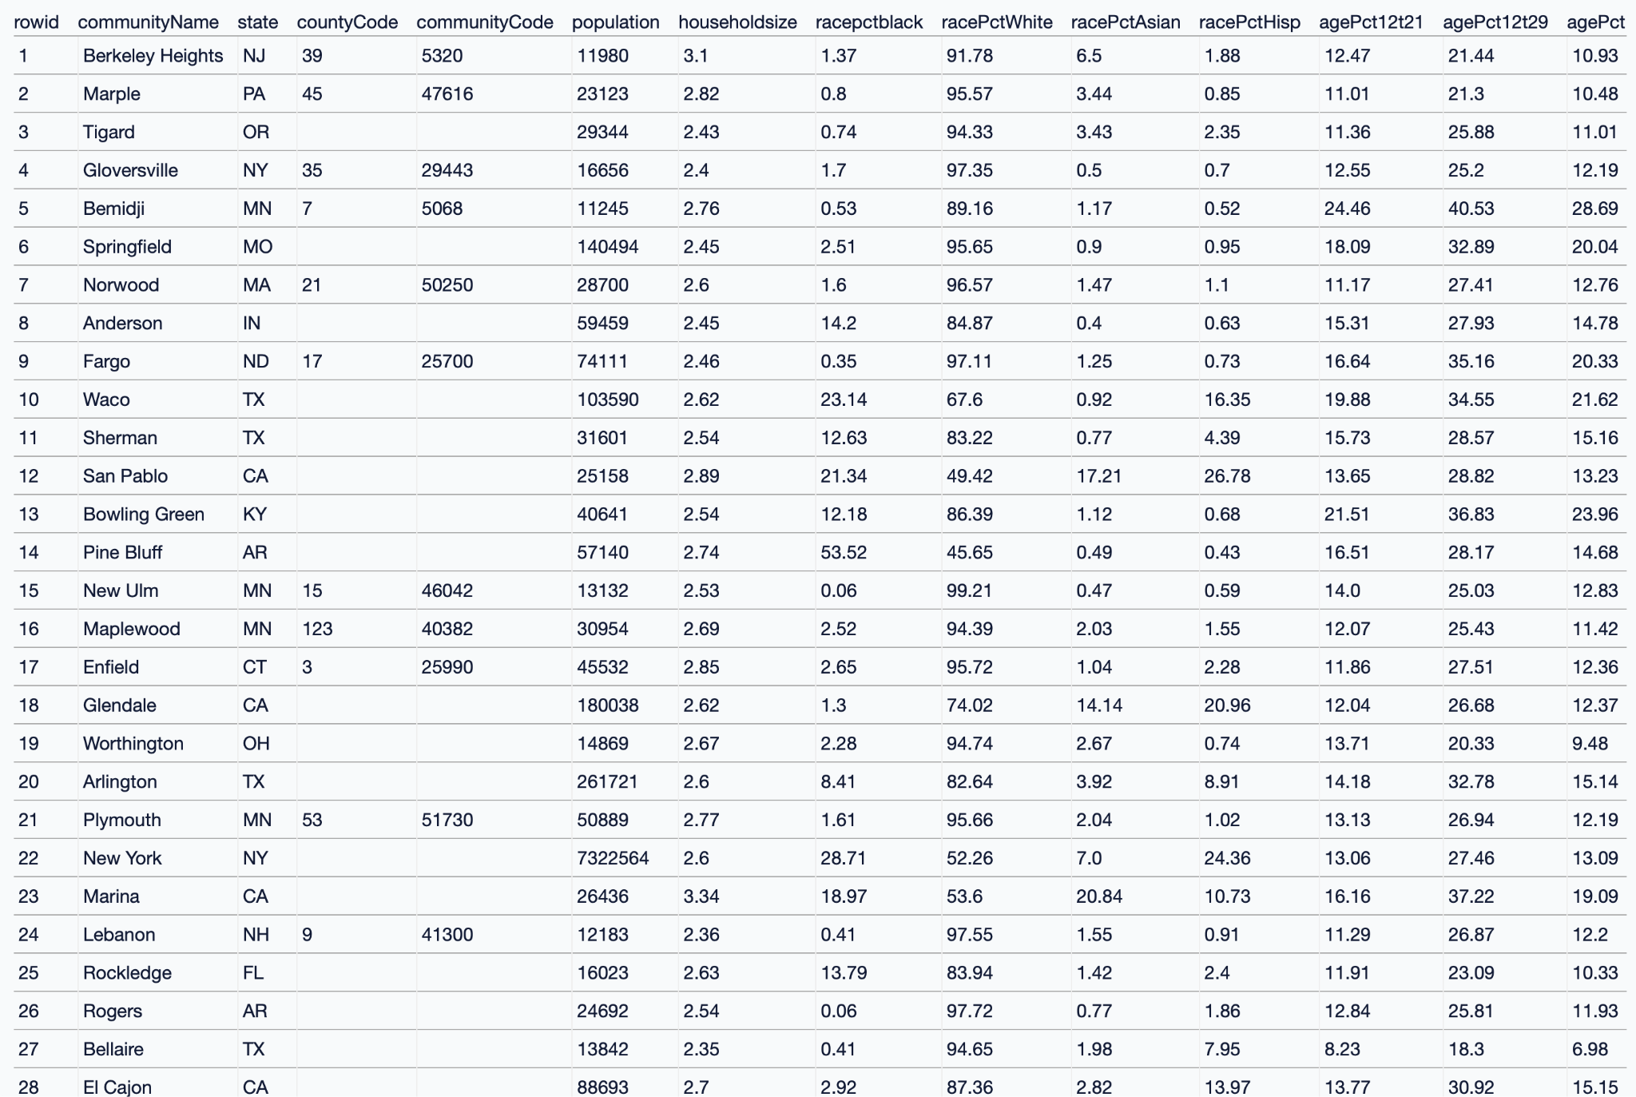
Sprint 1
Over 150 fields…

Slide 8
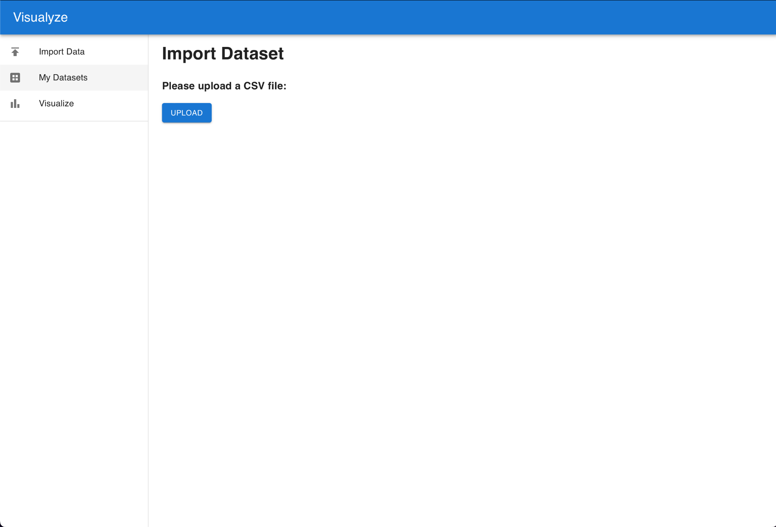
Sprint 2 Uploading datasets

Slide 9
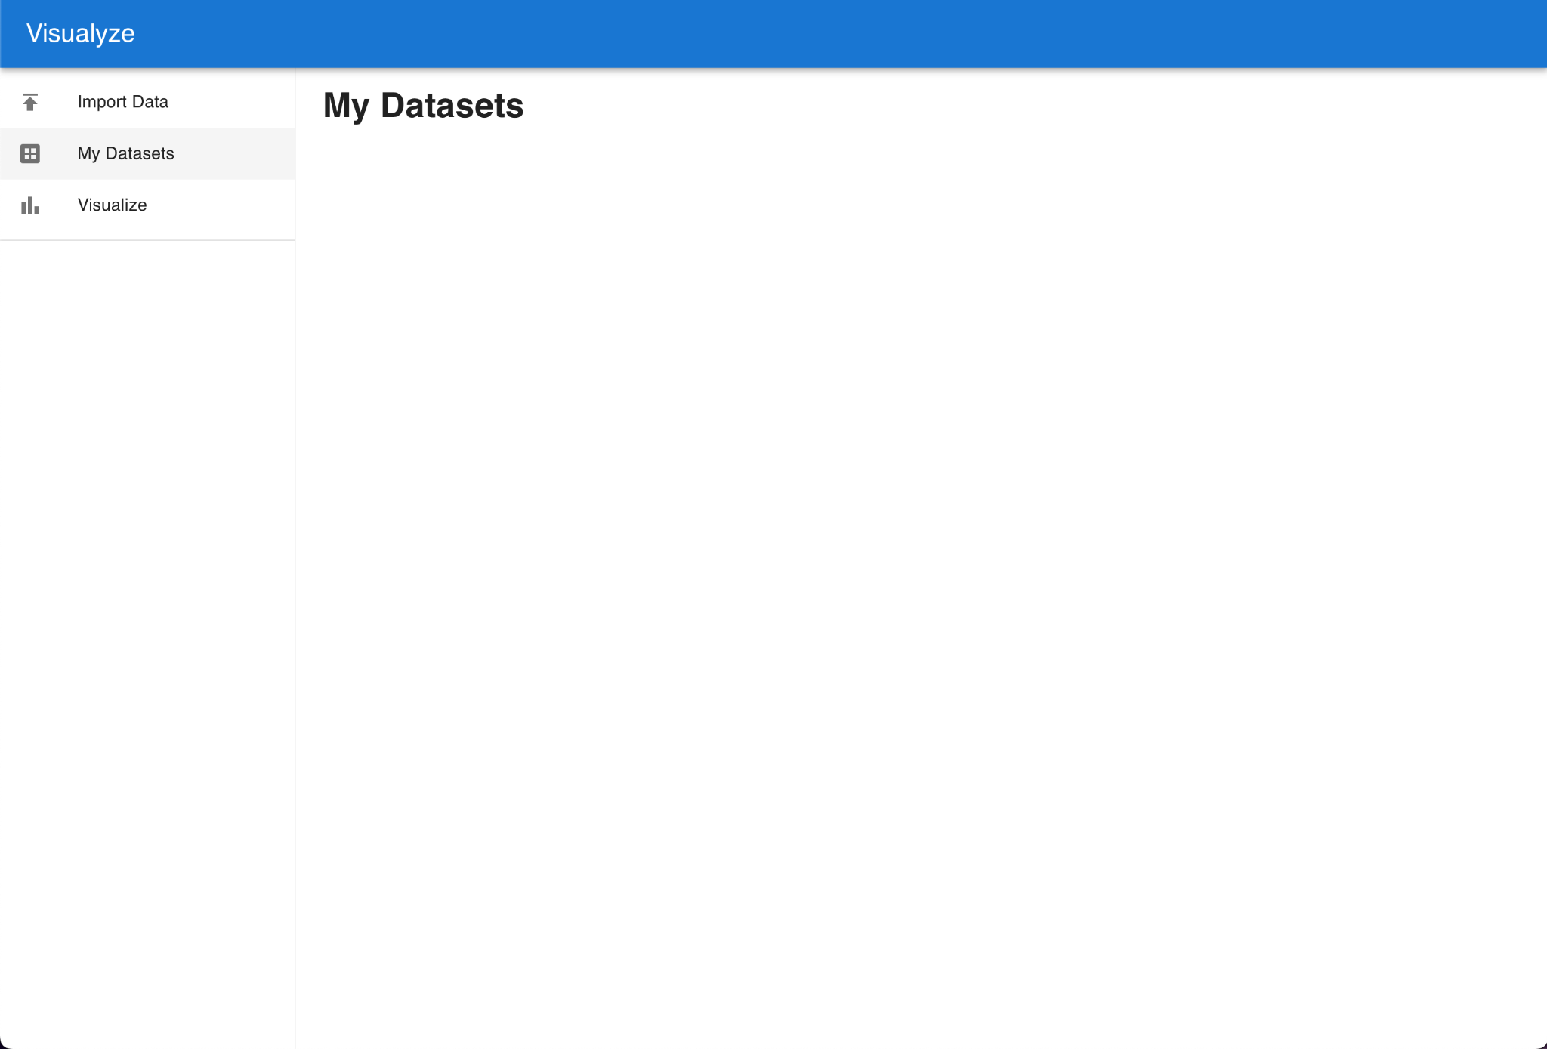
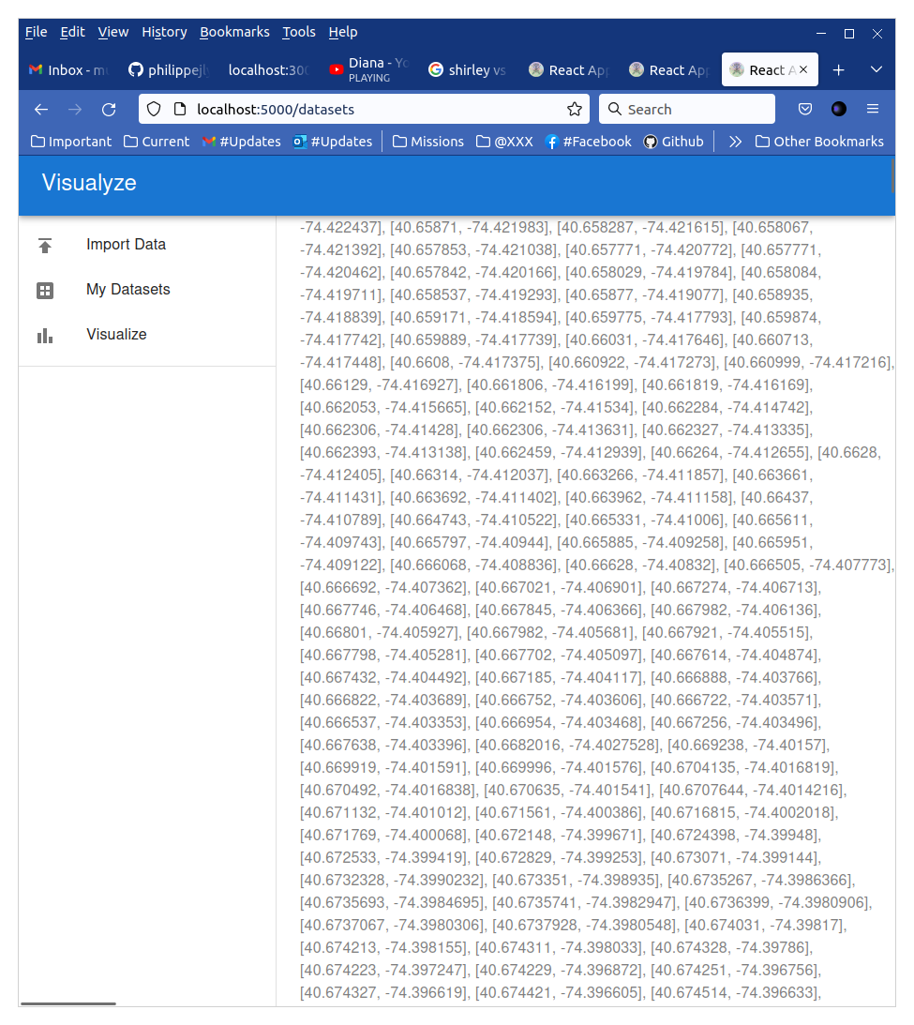
My datasets (S2)
Not functional…

Slide 10
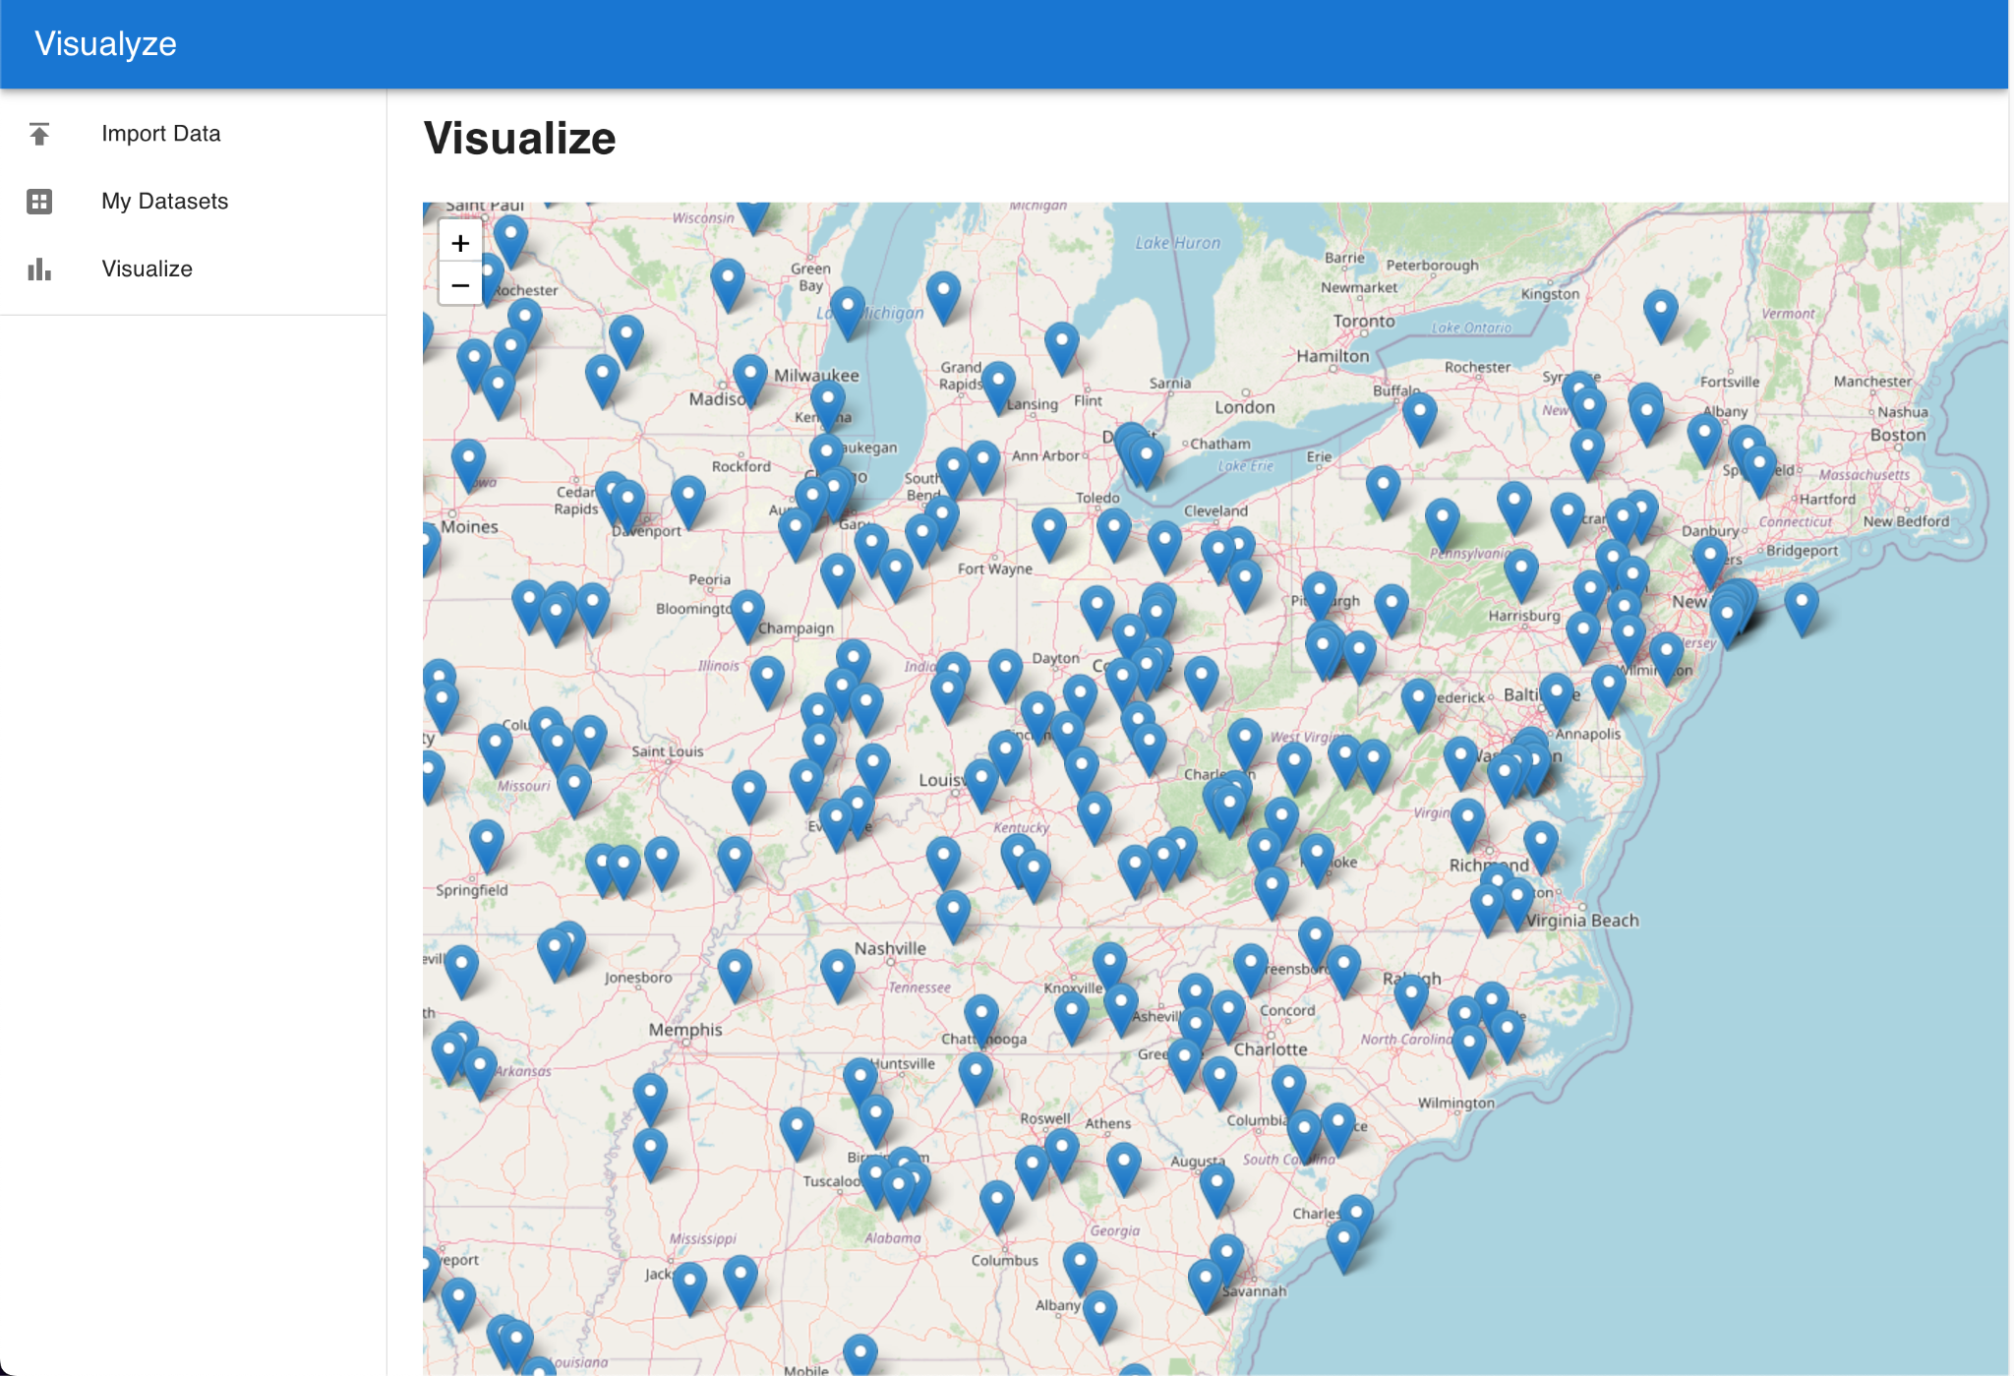
Visualization map (S2)

Slide 11
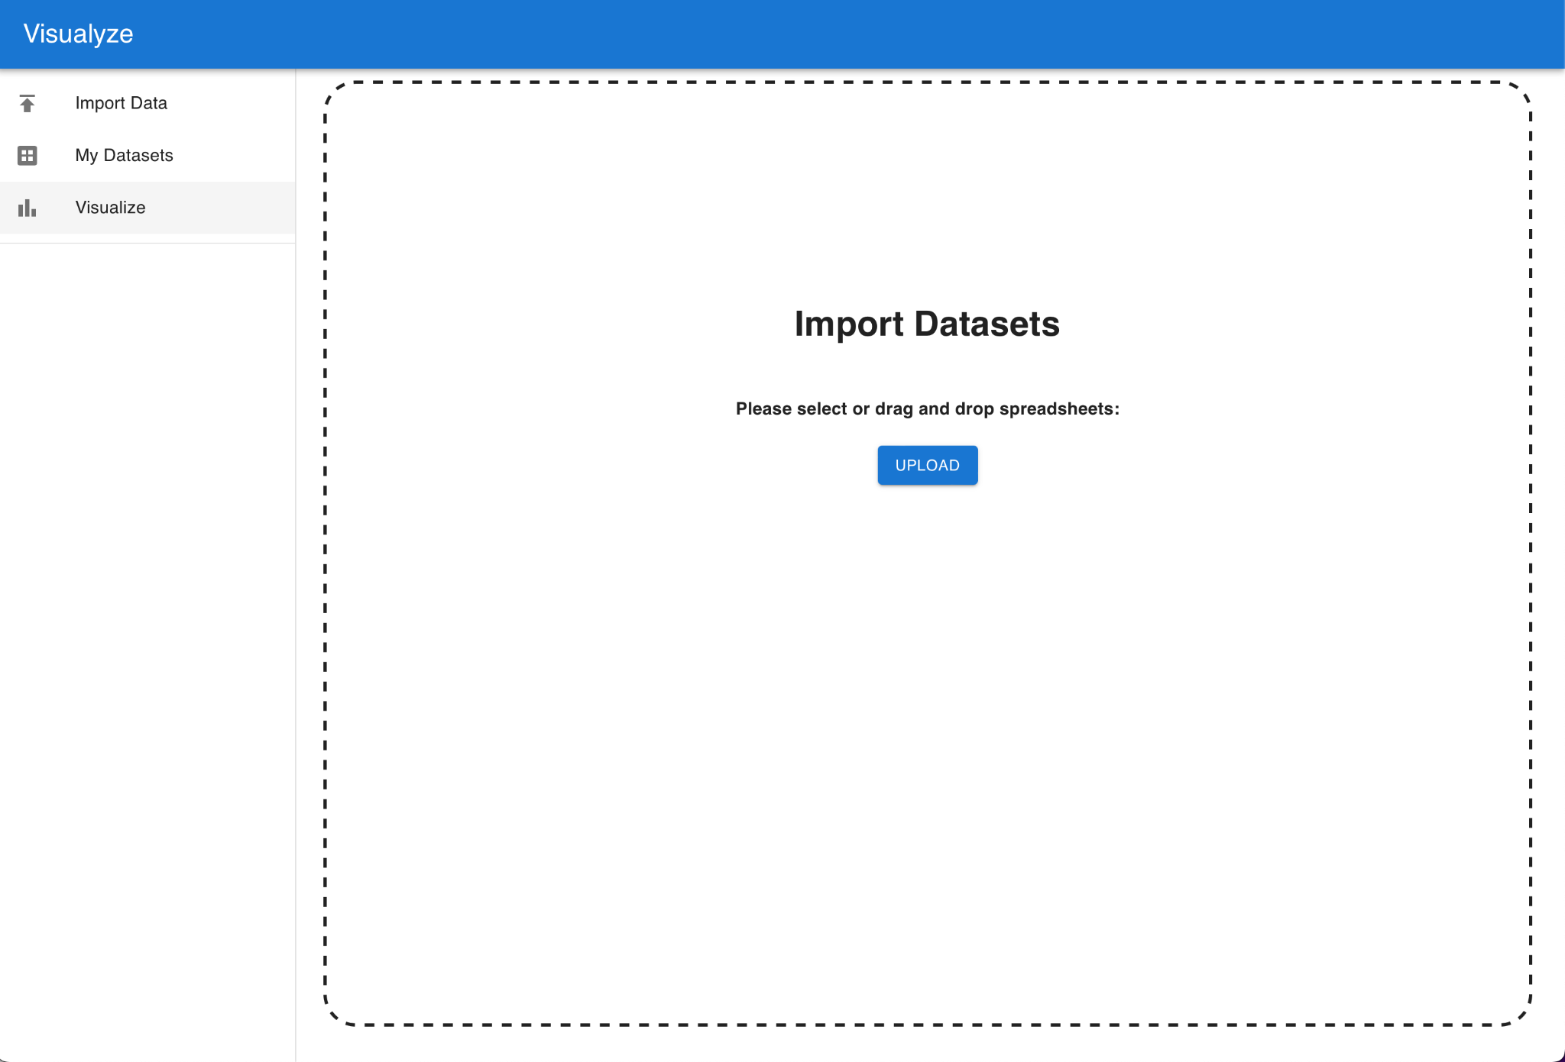
Import Datasets (S3)

Slide 12
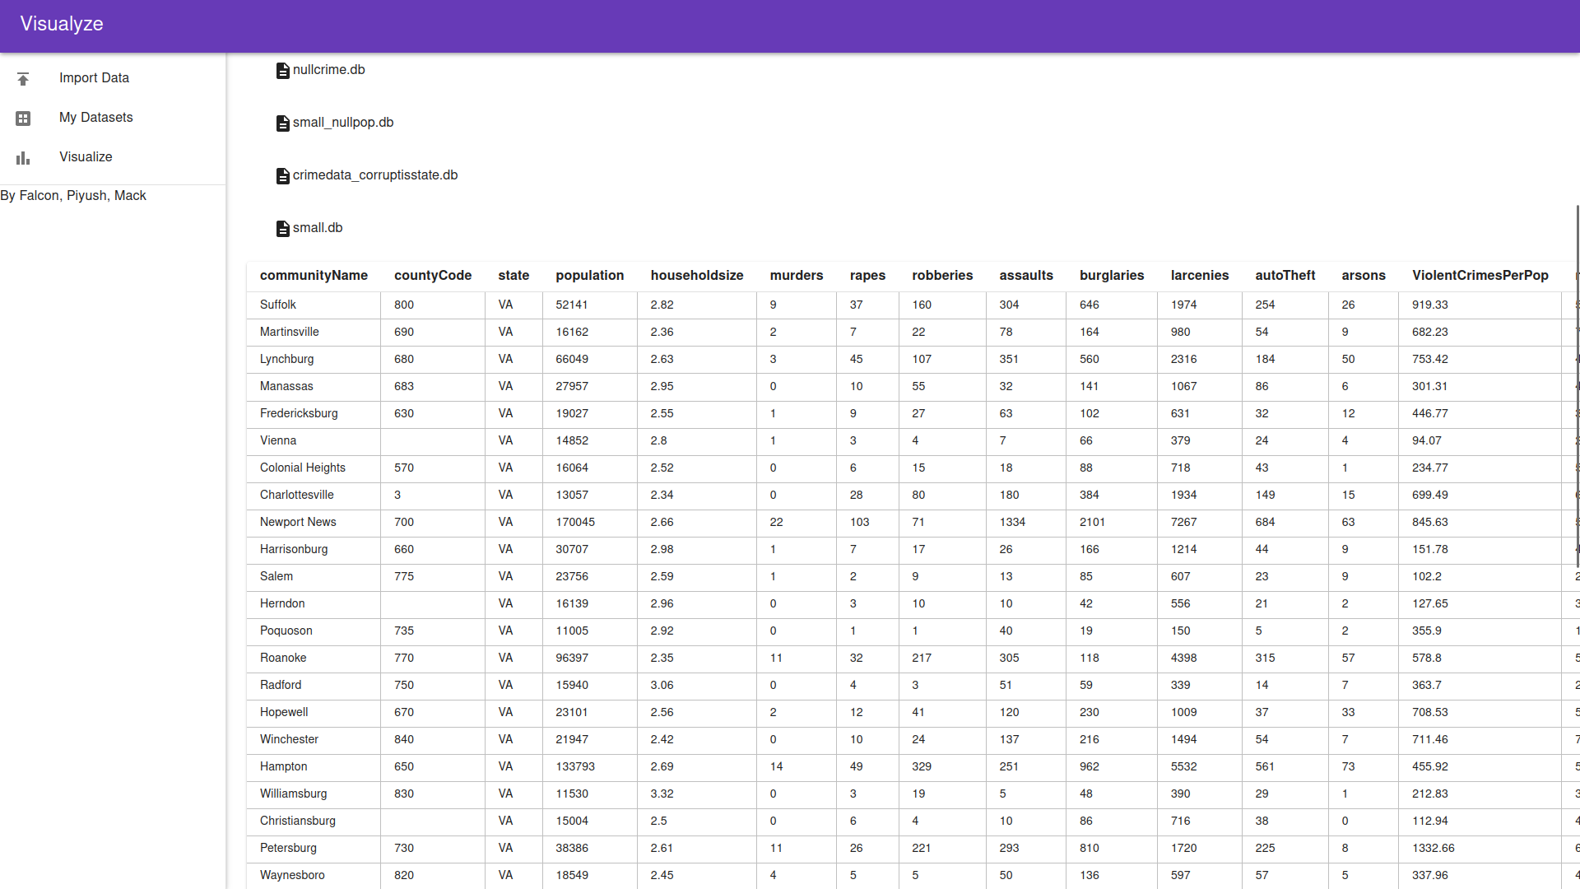
My datasets (S3)

Slide 13
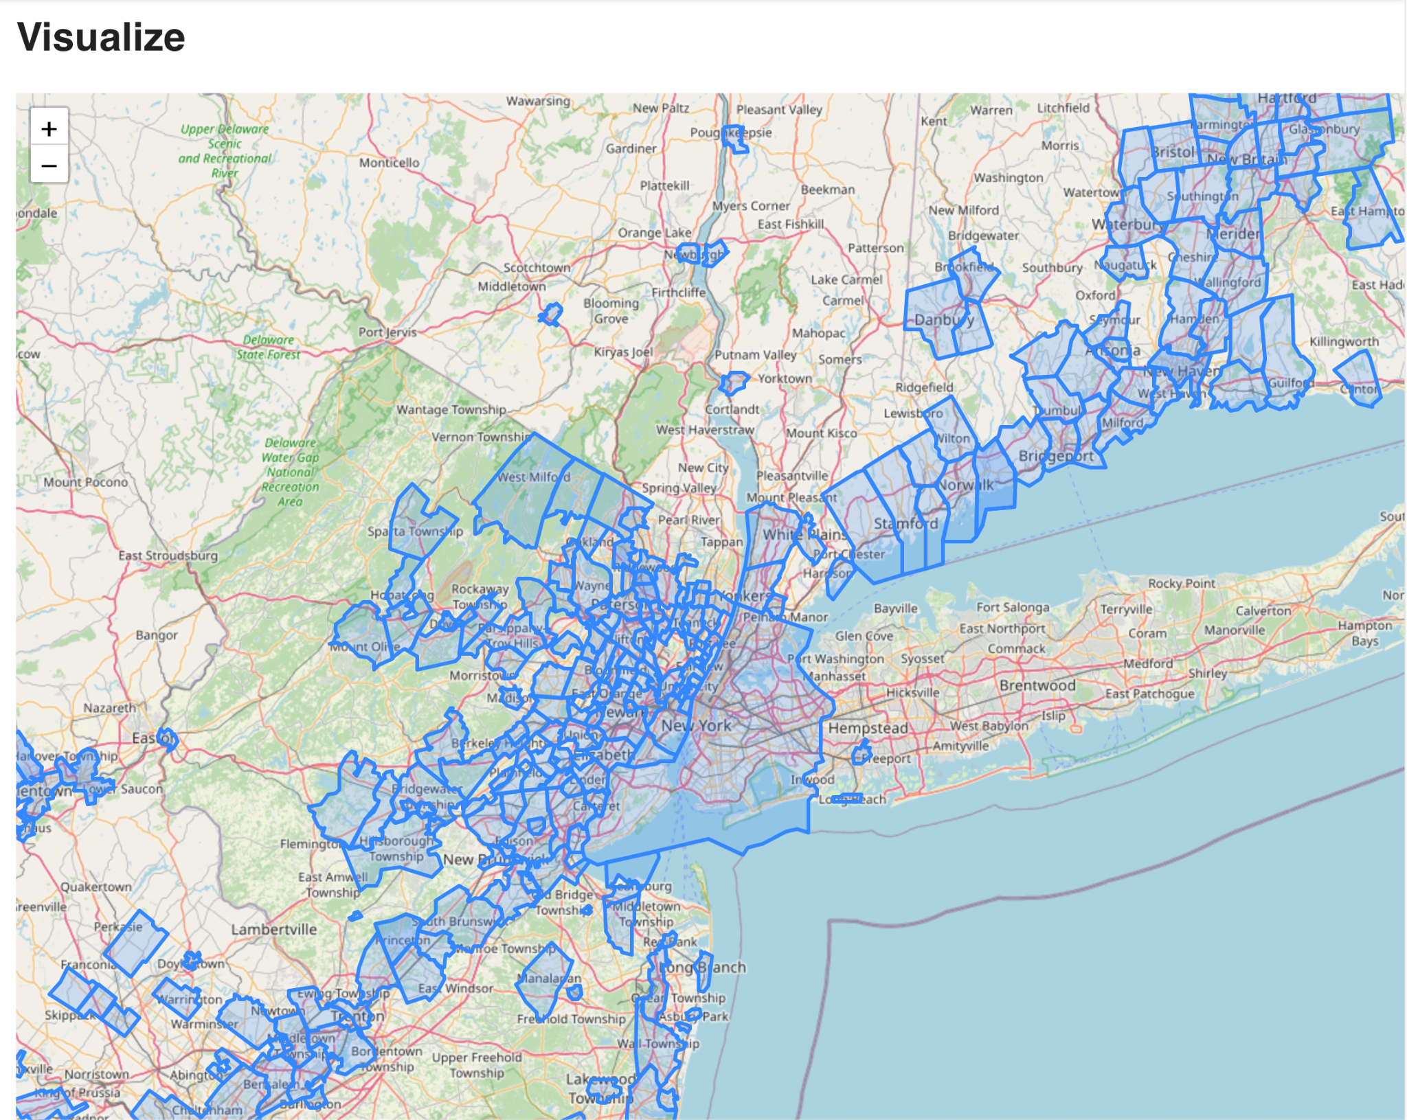
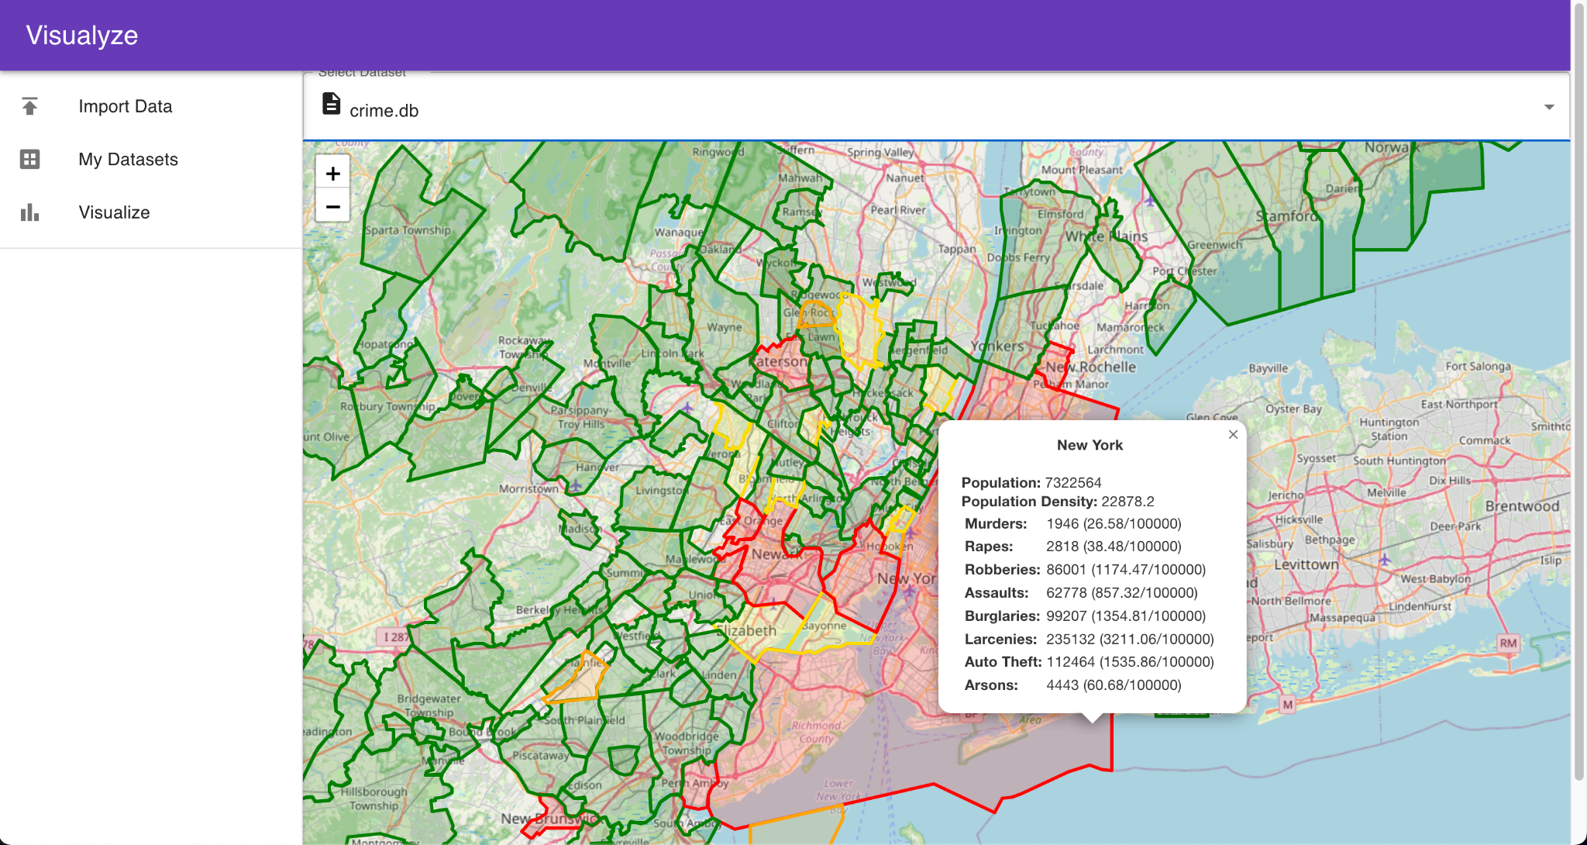
Visualization map (S3)

Slide 14
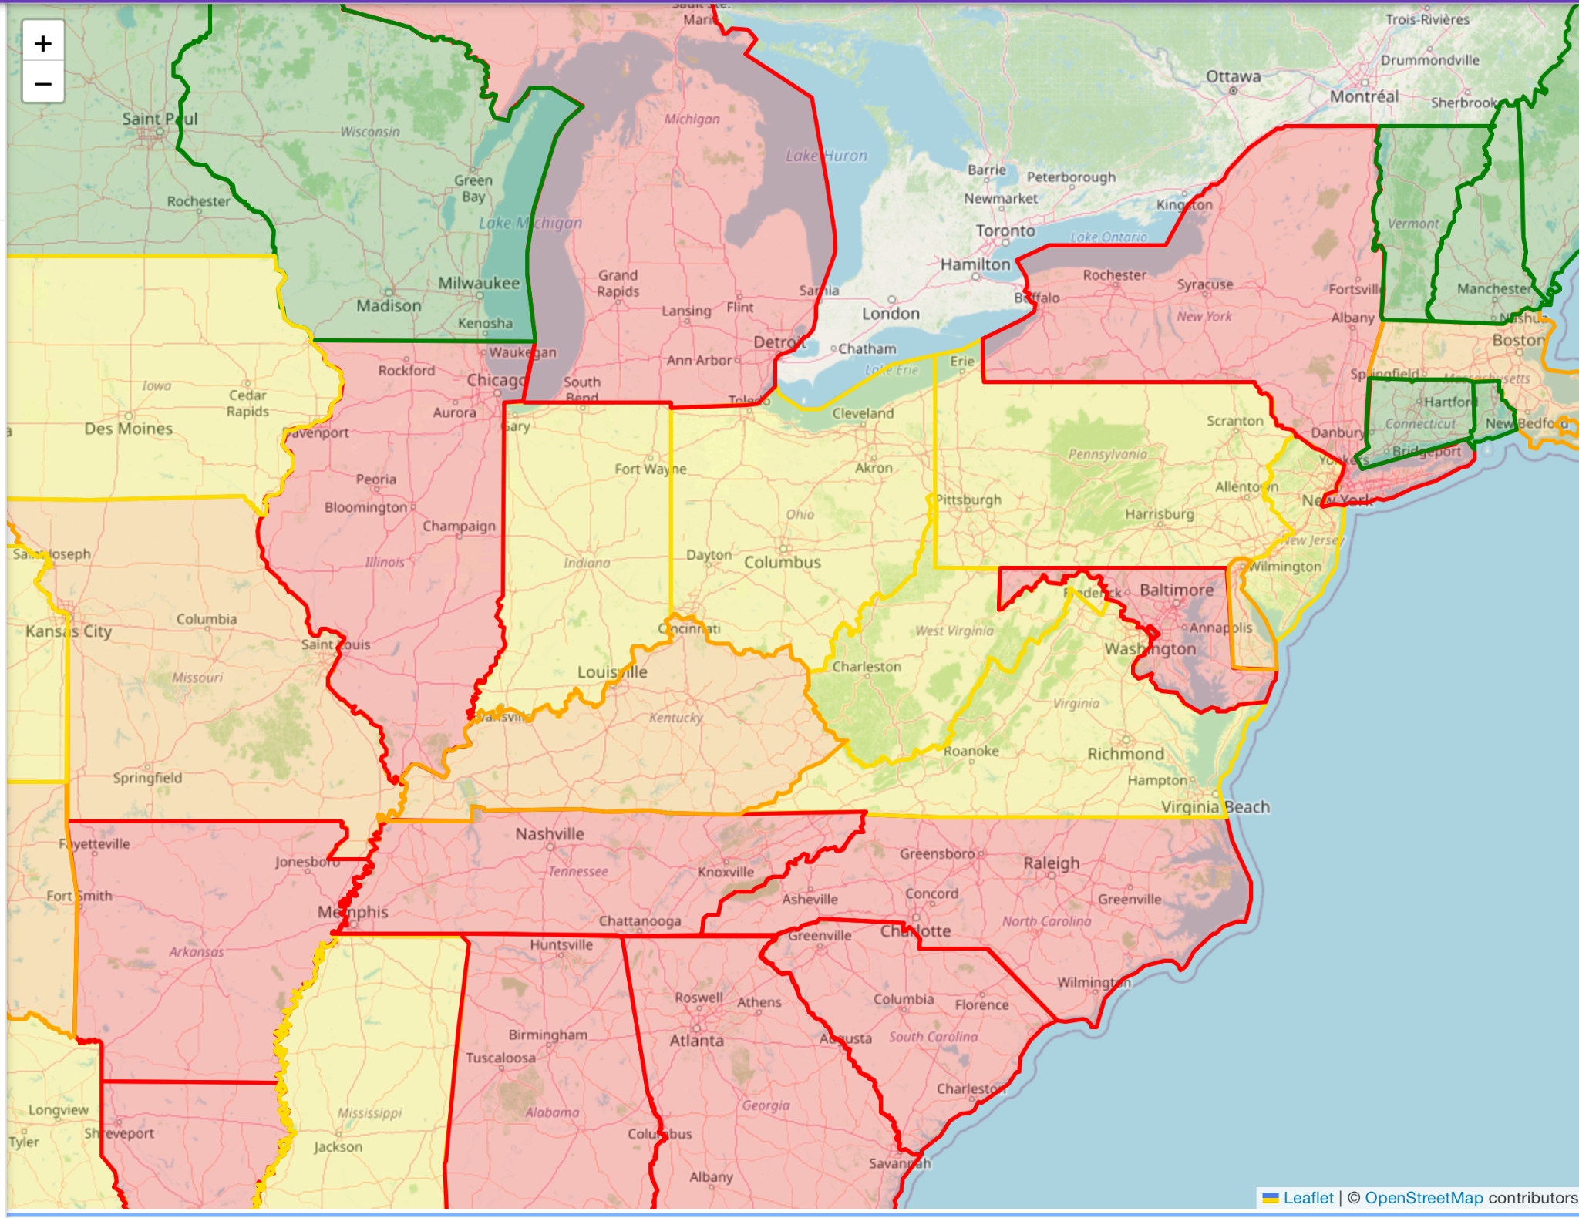
State level map (S3)

Slide 15
Contributions
Philippe
Responsible for geolocations, boundaries, unit tests, and Map Leaflet
Piyush
Responsible for React Dashboard UI, Import Datasets, Heatmap, Flask/GeoJson
Mack
Responsible for data integrity, logging, and My Datasets multi selection

Slide 16
Testing
We tested our program using PyTest (backend) and logging (front).
Acceptance Criteria:
The info stored on the front end matches exactly those on the backend including the attributes. The state level data are correctly summed, with special instructions on handling nulls.
Example:
Running Pytest to determine that there are 48 out of 50 states in the “sample” dataset.

Slide 17
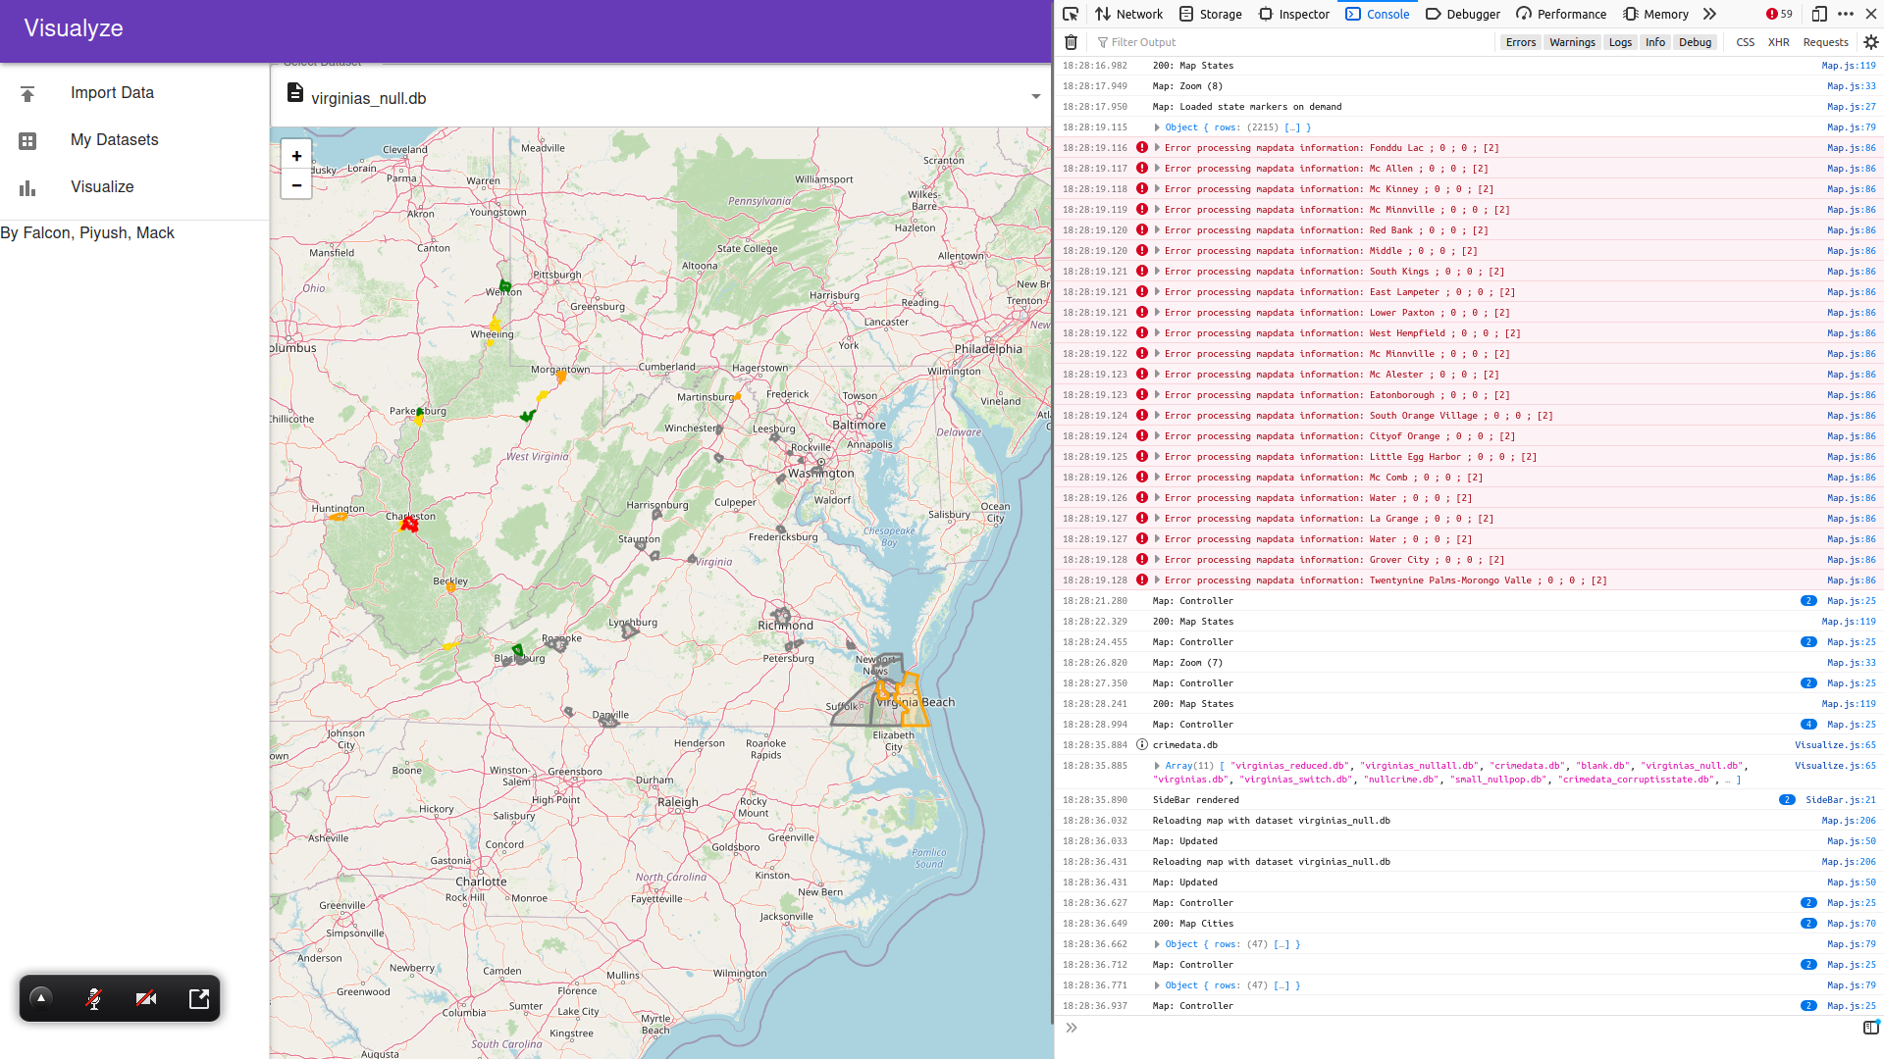
Testing & Logging

Slide 18
Mapping Problems
Dataset issues
Original dataset had incorrect lat and lon
When determining map boundaries of certain cities, lat and lon were swapped with eachother
Gathering this data requires using the openstreetmap api, this is rate limited to 1/sec. This means upload will be considerably slower
Speed
For large datasets, loading can be very slow and laggy at the city level

Slide 19
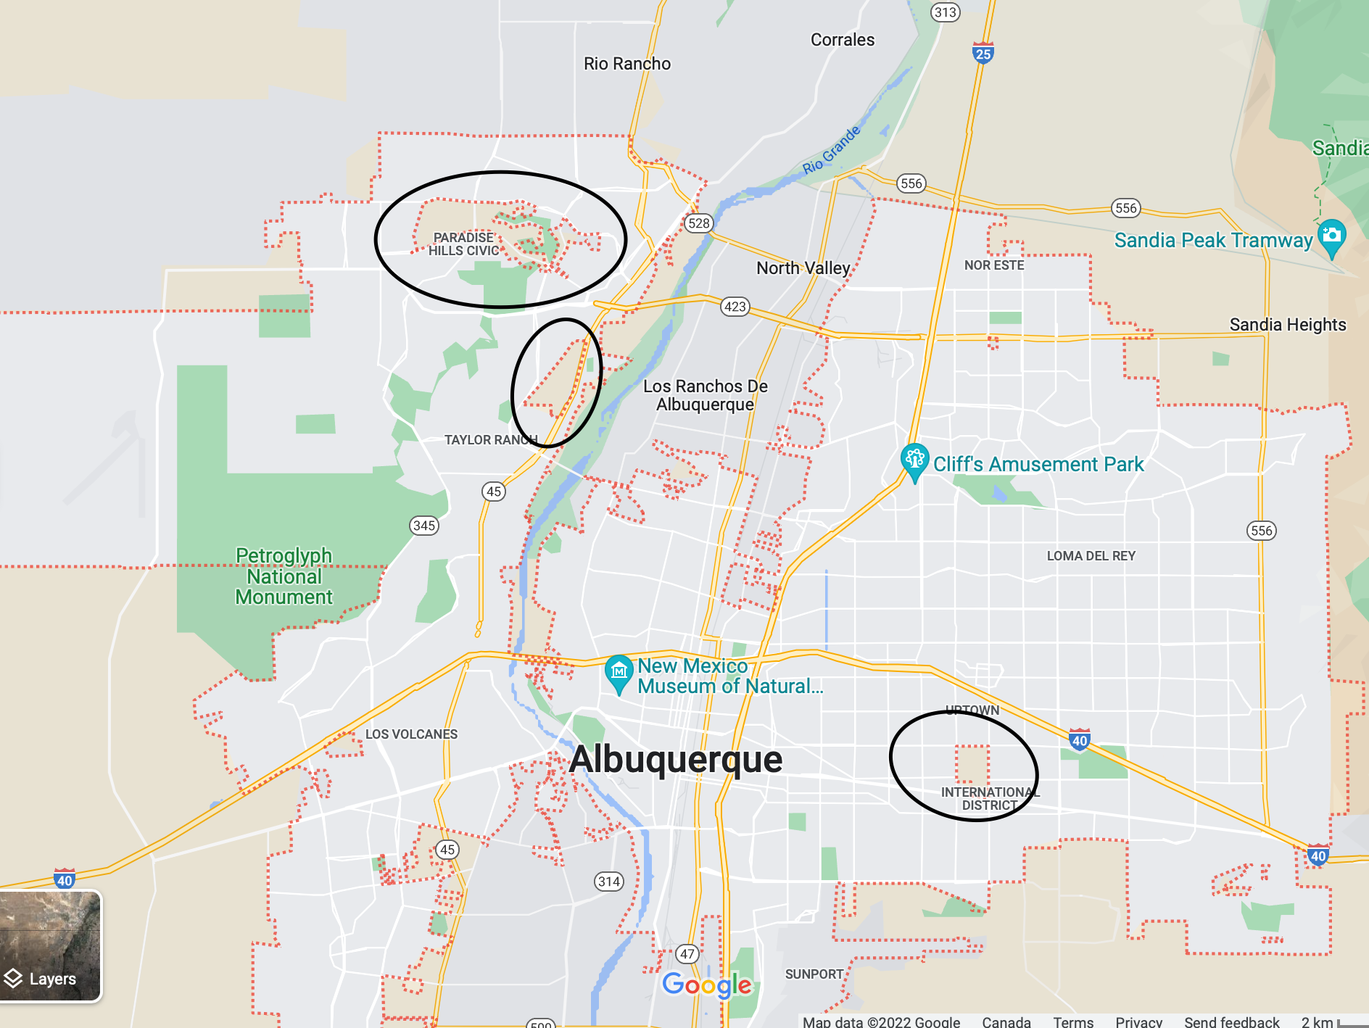
Strange boundaries
Many US cities have unincorporated areas not part of the actual city. This made cities not be continuous.
Ex:

Slide 20
Future Improvements
Our current schema involves over 150 fields, many of them quite extraneous and not for immediate use.
This means CSV files must be of a specific format, and special procedures must be done to handle CSV files that do not conform, both on the front and back end.
Null values also may need special consideration.
The sheer number of fields means live-updating will be very difficult, so all data will be cached.

Slide 21
Future Improvements
Cross platform, docker issues, dataset issues, quirks with cities overlapping with each other, not being continuous
Possible meeting irregularities
Flow on how to generate dataset can be somewhat awkward; especially that the geojson part can be time consuming and limited by the api call limit
Thus, db are stored locally in cache

Slide 22
Questions?

